Slide 1
CST2550 - 2025
Software Engineering and Management
Week 4: Advanced Data Structures - Graphs and Hash Tables
Ahmed Eissa
a.eissa@mdx.ac.uk

Slide 2
Learning Objectives
Understand complex data structures.
Implement graph algorithms.
Master hash table concepts.

Slide 3
1. Hash Tables

Slide 4
Concept Overview
Hash Function Principles
  Converts input (key) into a fixed-size integer, the hash code.
  Ensures uniform distribution to minimise collisions.
Collision Resolution
  Separate Chaining: Stores collided keys in a linked list or other structure.
  Open Addressing: Finds the next available slot using methods like linear probing or quadratic probing.
Load Factor and Resizing
  Load Factor: The ratio of stored elements to the number of slots.
  Resizing: Rehashing to a larger table size when the load factor exceeds a threshold.
Notes:
The Hashtable in C# is a collection that stores (Keys, Values) pairs. Here, the Keys are used to find the storage location. A HashTable is immutable and cannot have duplicate entries.

Slide 5
Implementation Considerations
Choosing Hash Functions
  Must be deterministic, uniform, and efficient.
Handling Collisions
  Effective collision resolution strategies ensure optimal performance.
Performance Optimisation
  Aim for O(1) average-case time complexity for insertion, deletion, and search.
Notes:
If you meant "why do we use the Dictionary<TKey, TValue> class instead of the Hashtable class?", then it's an easy answer: Dictionary<TKey, TValue> is a generic type, Hashtable is not. That means you get type safety with Dictionary<TKey, TValue>, because you can't insert any random object into it, and you don't have to cast the values you take out.

Slide 6
2. Graphs

Slide 7
Graph Fundamentals
Vertices and Edges
  Vertices: Nodes representing entities.
  Edges: Connections between vertices, representing relationships.
Directed vs Undirected Graphs
  Directed Graphs: Edges have a direction (e.g., one-way streets).
  Undirected Graphs: Edges have no direction (e.g., mutual friendships).
Weighted Graphs
  Edges have weights to represent costs or distances.

Slide 8
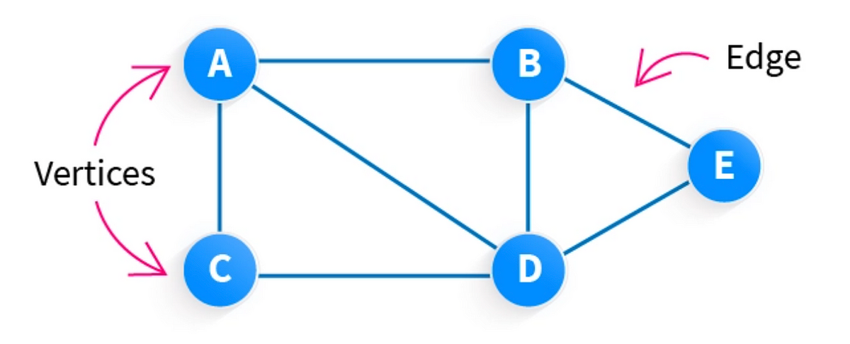
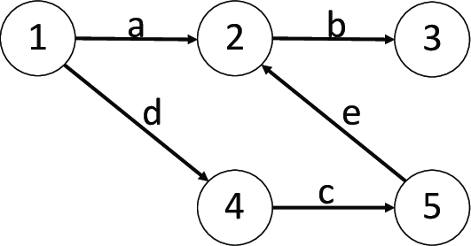
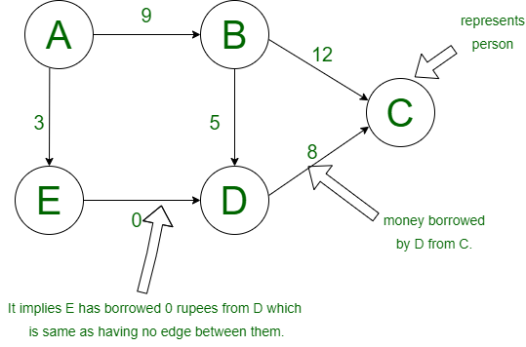
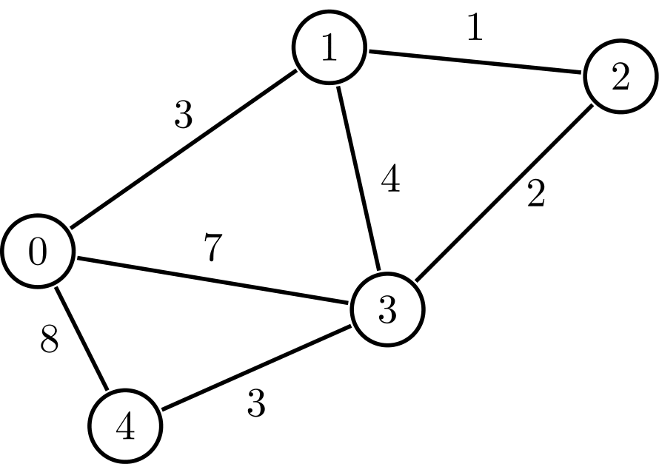
Graph Fundamentals (Examples)

Slide 9
Graph Algorithms
Depth-First Search (DFS)
  Explores as far as possible along each branch before backtracking.
Breadth-First Search (BFS)
  Explores all vertices at the current depth level before moving deeper.
Shortest Path Algorithms
  Dijkstra’s Algorithm: Finds the shortest path from a source vertex to all other vertices in a weighted graph.

Slide 10
Summary and Q&A
Hash Tables: Key principles, collision handling, and implementation considerations.
Graphs: Fundamental concepts and traversal/search algorithms.
Dijkstra’s Algorithm: Practical example of finding shortest paths.

Slide 11
Questions for Discussion:
What are the trade-offs between separate chaining and open addressing in hash tables?
How would you adapt Dijkstra’s Algorithm for a directed graph?
What scenarios might require prioritising BFS over DFS?

Slide 12
Practical Examples

Slide 13
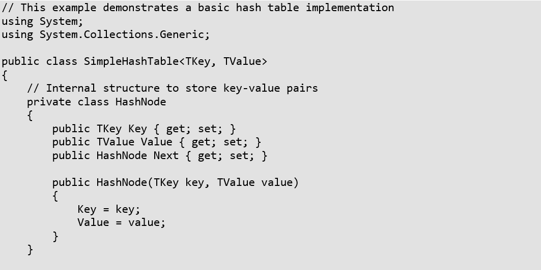
Example 1: Hash Table Implementation

Slide 14
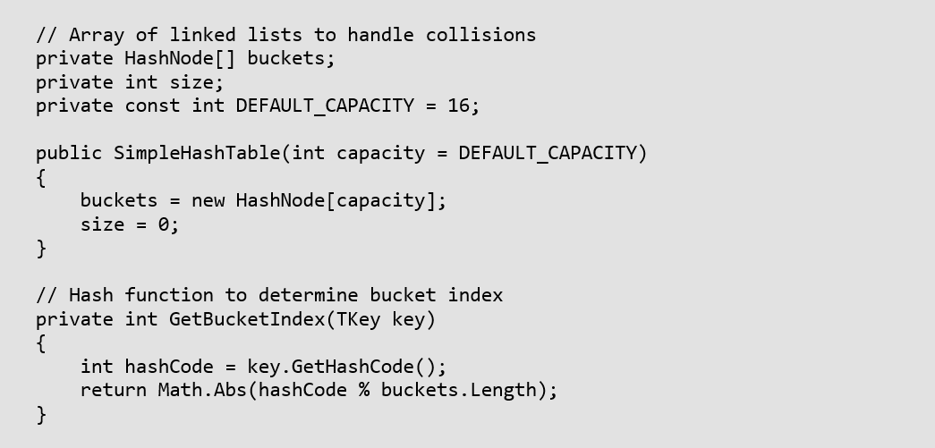
Example 1: Hash Table Implementation

Slide 15
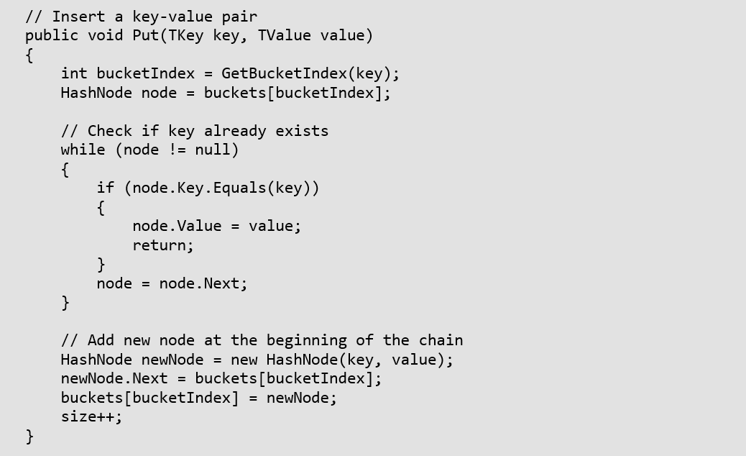
Example 1: Hash Table Implementation

Slide 16
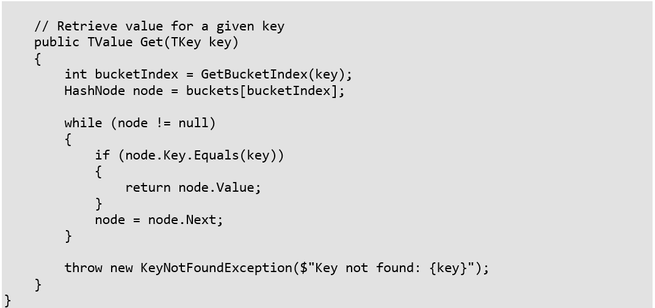
Example 1: Hash Table Implementation

Slide 17
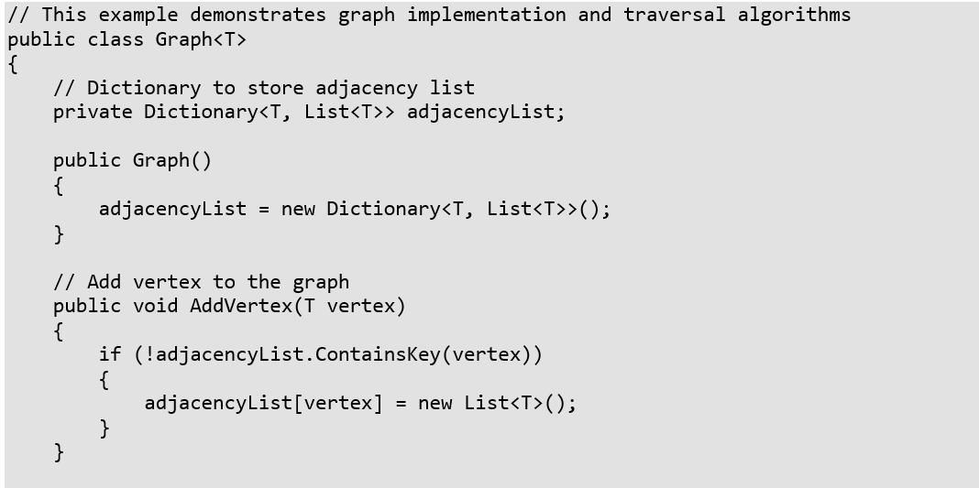
Example 2: Graph Implementation and Algorithms

Slide 18
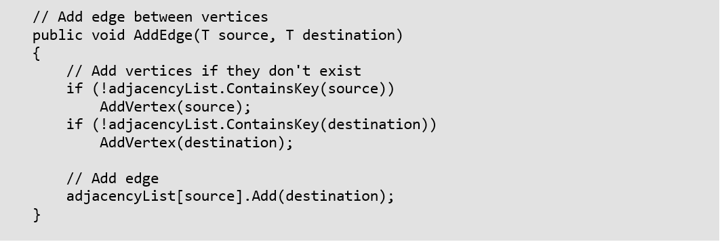
Example 2: Graph Implementation and Algorithms

Slide 19
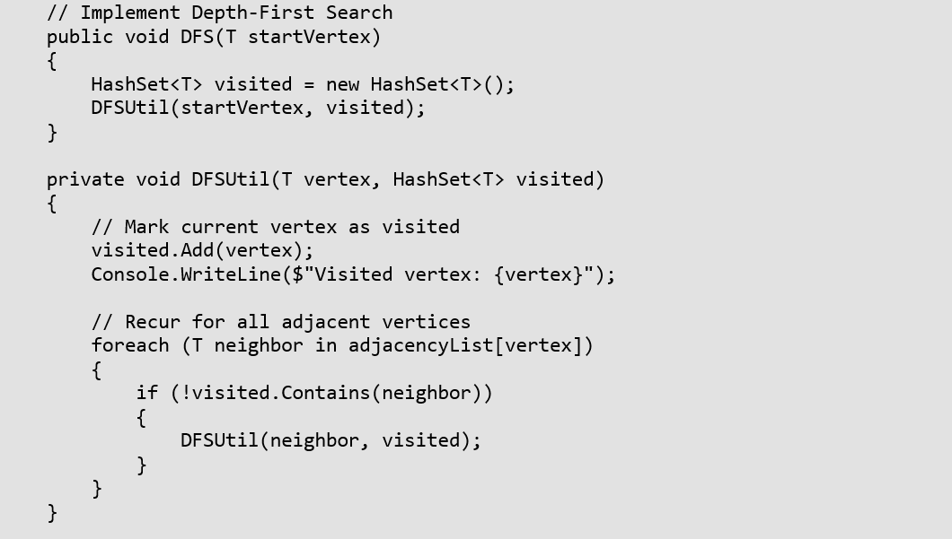
Example 2: Graph Implementation and Algorithms

Slide 20
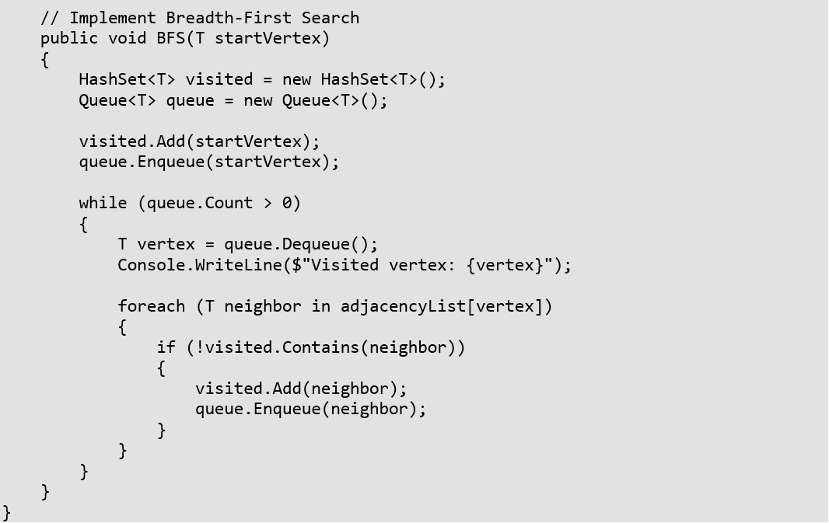
Example 2: Graph Implementation and Algorithms

Slide 21
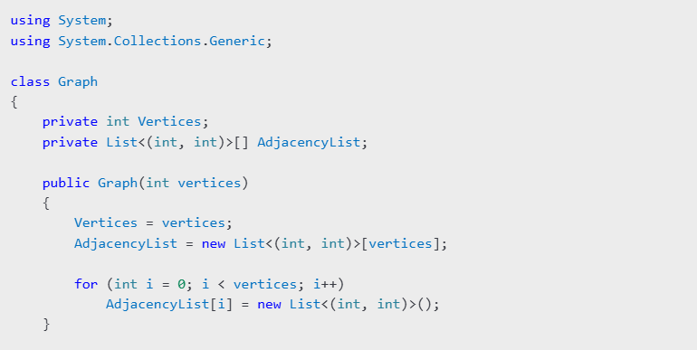
Example 3: Code Example for Dijkstra’s Algorithm

Slide 22
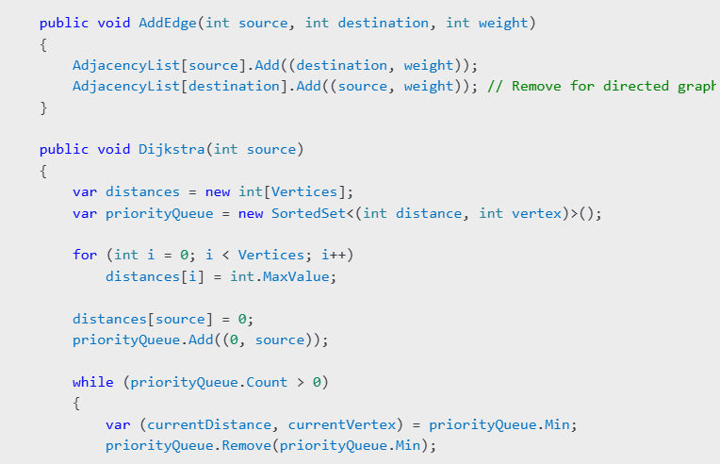
Example 3: Code Example for Dijkstra’s Algorithm

Slide 23
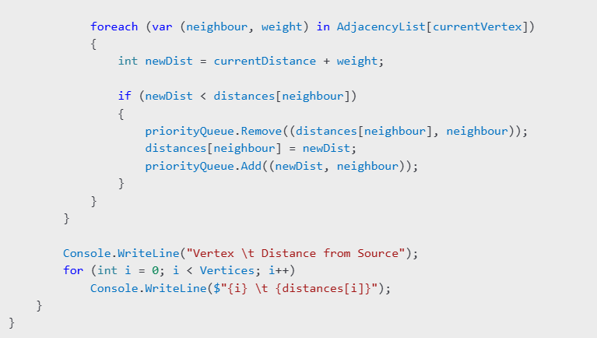
Example 3: Code Example for Dijkstra’s Algorithm

Slide 24
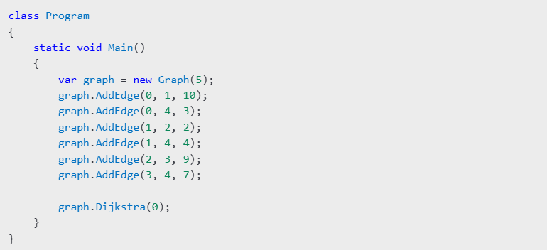
Example 3: Code Example for Dijkstra’s Algorithm

Slide 25
Practice Exercises
Hash Table Implementation
  Implement a hash table with linear probing
  Add methods for deletion and resizing
  Handle collisions using double hashing
Graph Algorithms
  Implement Dijkstra's shortest path algorithm
  Create a method to detect cycles in a graph
  Implement topological sorting

Slide 26
Additional Resources
Graph Theory Fundamentals
Hash Table Design Considerations
Advanced Data Structures in C#

Slide 27
Next Week
Introduction to Database and SQL

